Slide 1
JustPicked
Team E Prototype Slides
Zenix Teo
Lim Wee Liang Kelven
Tay Gao Jun
Syed Packir Mohamed Synul Banu
Jonita Limbu

Slide 2
Details Of The App

Slide 3
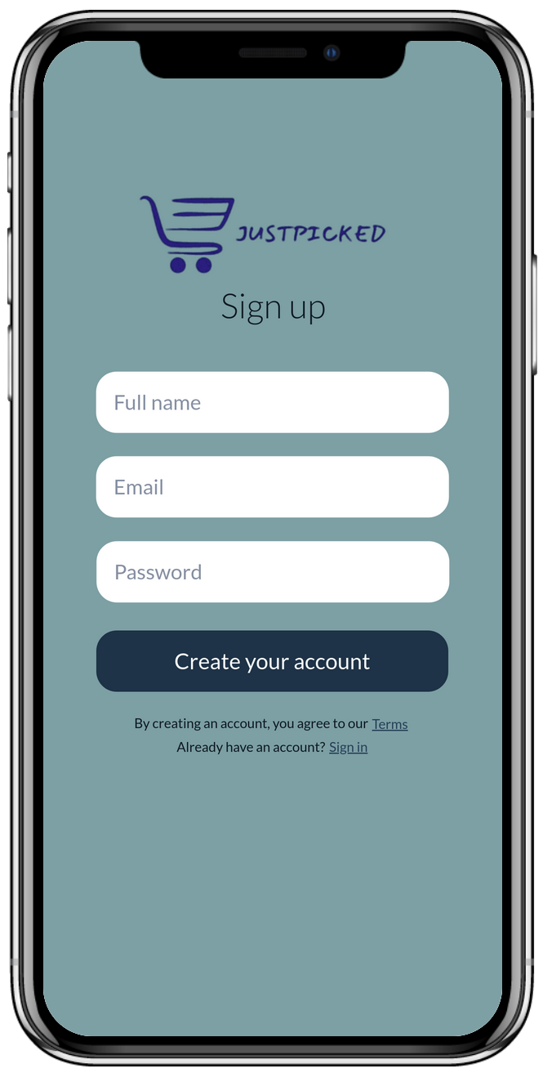
The app provides a user registration feature that allows users to create new accounts.
Notes:
The app provides a user registration feature that allows users to create new accounts.

Slide 4
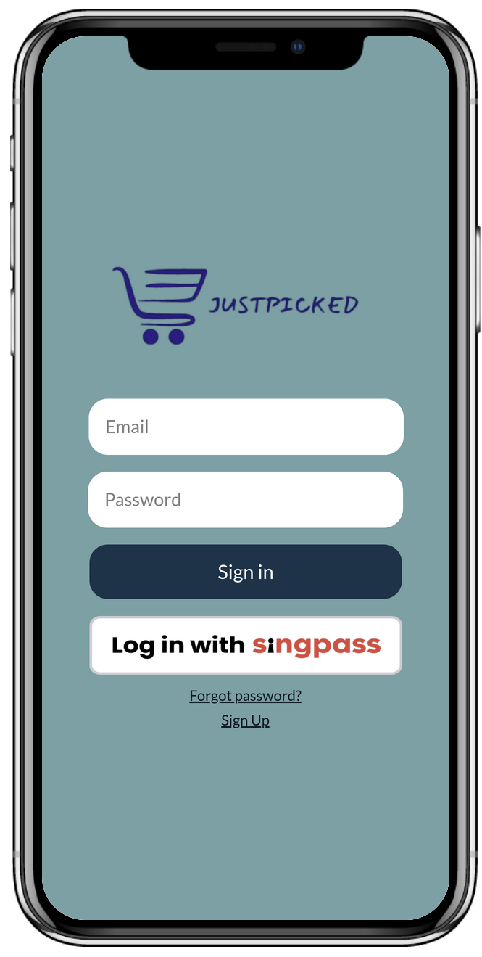
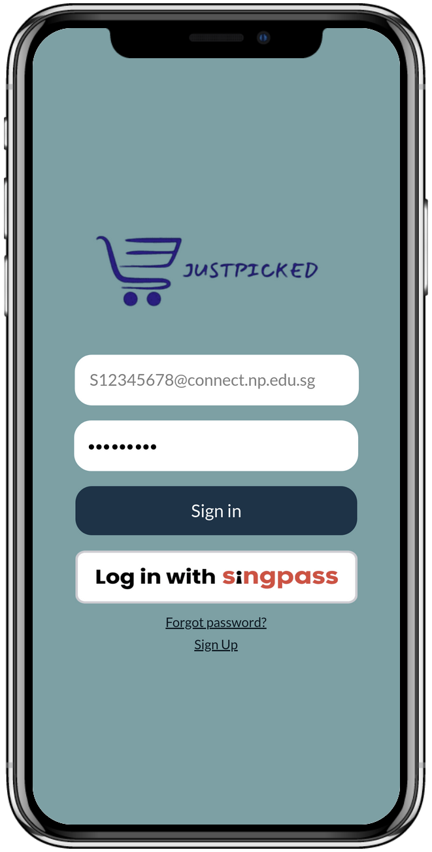
Login page for returning users
Users can login with SingPass
Notes:
The app provides a login page for returning users.
If the user have SingPass, he or she can also use SingPass to register or signin the app.

Slide 5
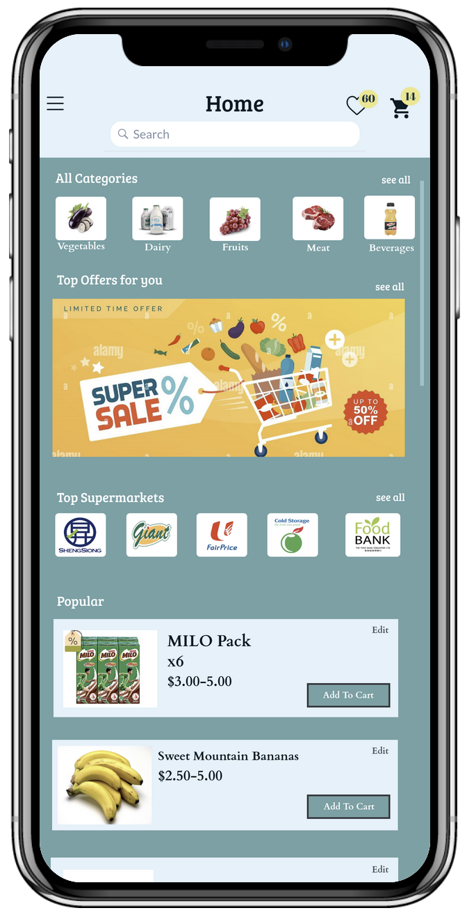
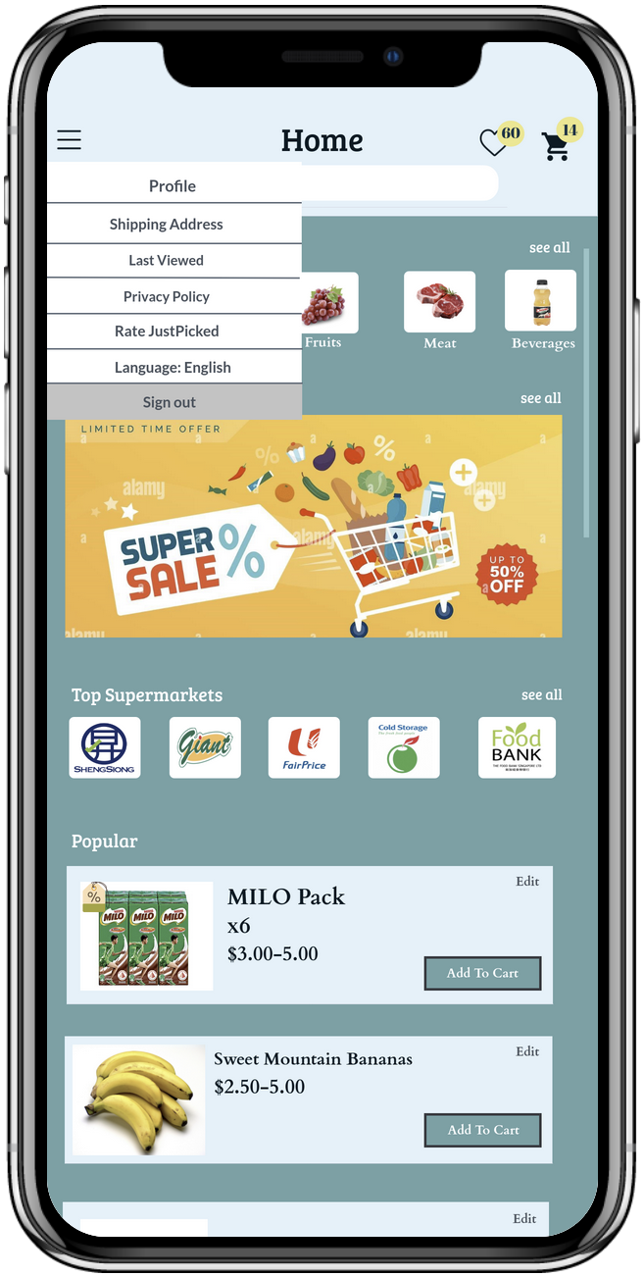
Liked and to buy products at top right hand corner
Menu to navigate to other pages in the app
Access to different categories
More bundles and sale items appear when swiped
Homepage showing different markets link on top
Popularly sold items at the bottom
Notes:
The app have a minimalistic homepage which shows :
Different categories of groceries
Top Offers
Top Supermarkets
Popular Products
It also consist of a search menu for users to search for their desired products.
Products which are liked or added to cart by the users will also show on the “liked” icon or “cart” icon.
Users can also navigate to :
Profile
Shipping Address
Last Viewed Products
Privacy Policy of the app
Rate JustPicked app
Change Language of the app
Sign Out of the app

Slide 6
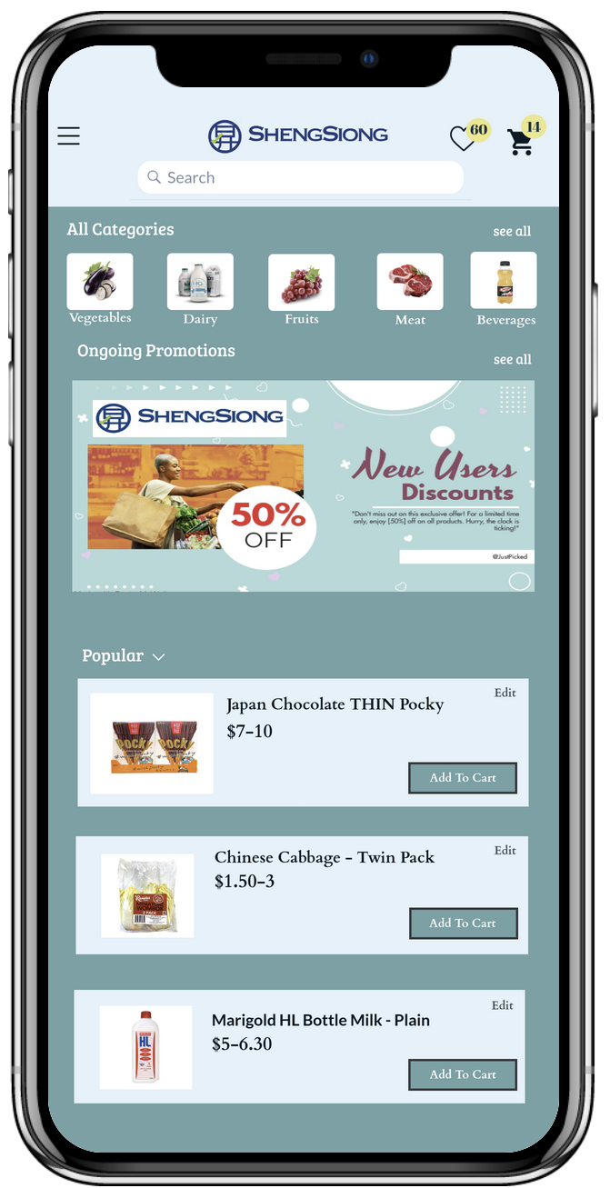
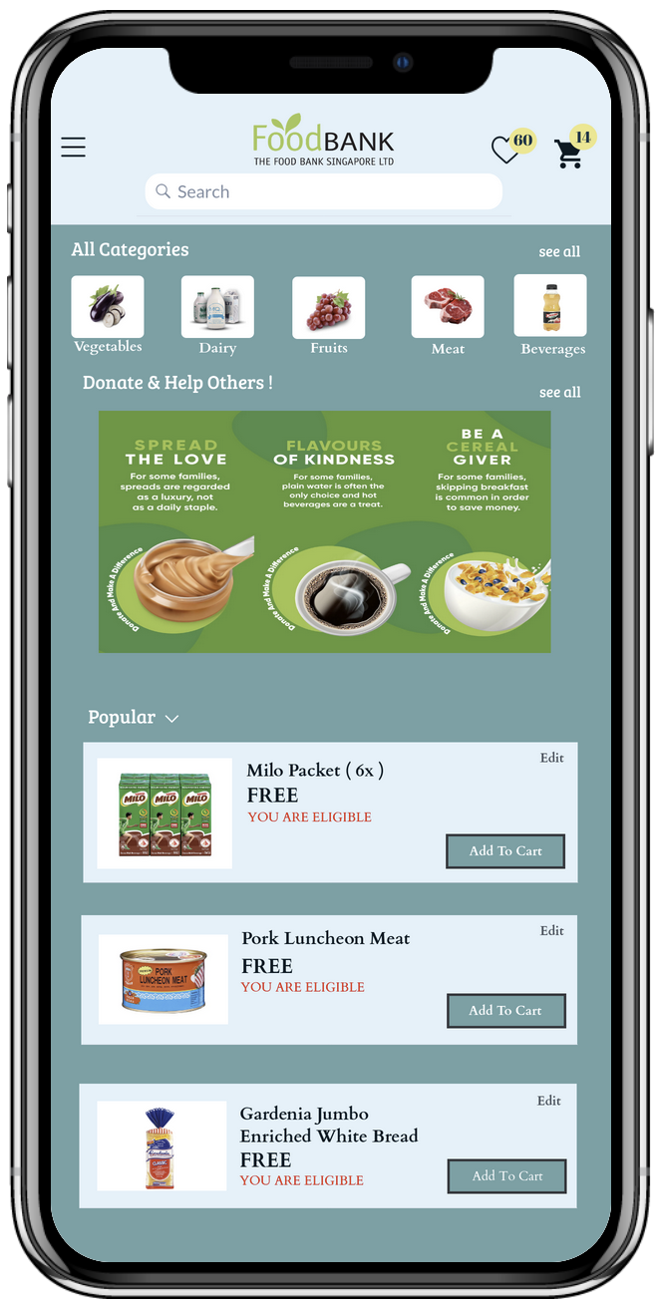
Foodbank products are exclusive to low-income families
More flash deals and discounted offers on homepage
Products from food bank are free
Notes:
The app have different supermarket and NGOs such as ShengSiong and FoodBank,
Where users is able to shop based on the supermarket and NGOs.
Promotions available will based on the supermarket or NGOs the user selected.
If NGOs like FoodBank is chosen,
If the user is eligible for financial assistance, he or she will be able to purchase the item for free.
FoodBank SG acquires donated food (much of which would otherwise be wasted) from farms, manufacturers, distributors, retail stores, restaurants, consumers, and other sources; and makes it available to those in need via a network of member beneficiaries. These member beneficiaries include various types of homes, family service centres, soup kitchens, and other Voluntary Welfare Organizations (VWOs) (FoodBank, 2023).
Reference Link :
https://foodbank.sg/about/

Slide 7
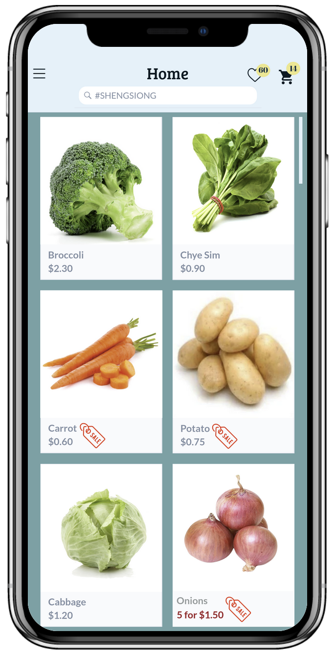
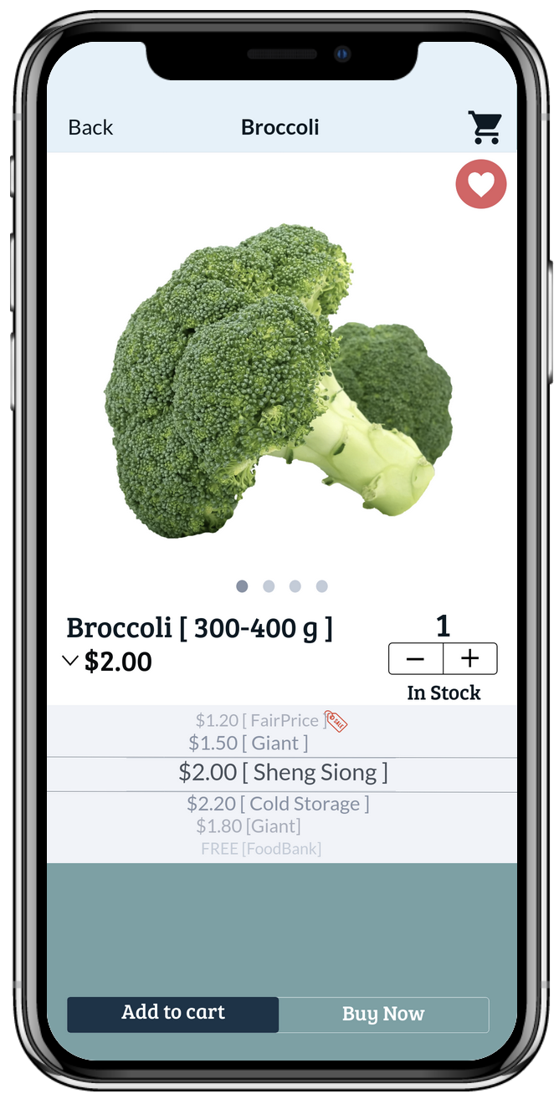
When a product is selected, the add to cart page appears
Under a certain product category, e.g. vegetables, all vegetables will appear
Items going on sale at heavily discounted price appears with the red ‘SALE’ tag
Choose the quantity
View and compare prices from various marts
Notes:
The app features a search bar where user can search for desired items or supermarket.
It will also show products which are on sales with a “sales” icon.
If user select a product, example, Broccoli, the user is able to choose between all the supermarkets and NGOs for the cheapest deals.
NGOs options like FoodBank, will only be shown to users who are eligible for financial subsidies.

Slide 8
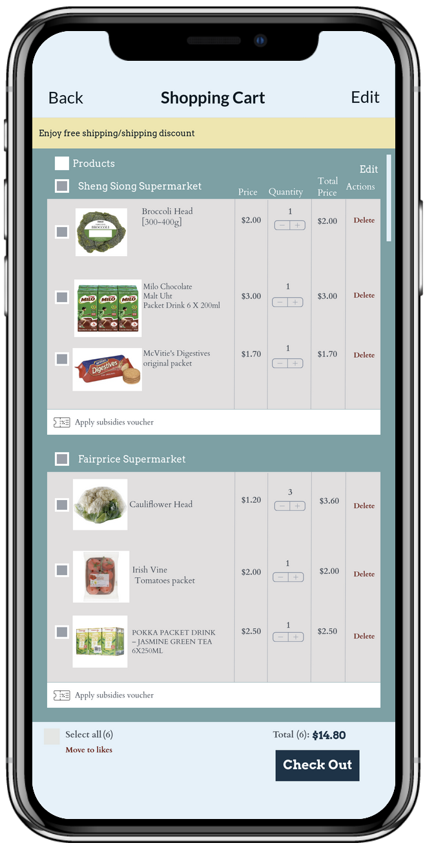
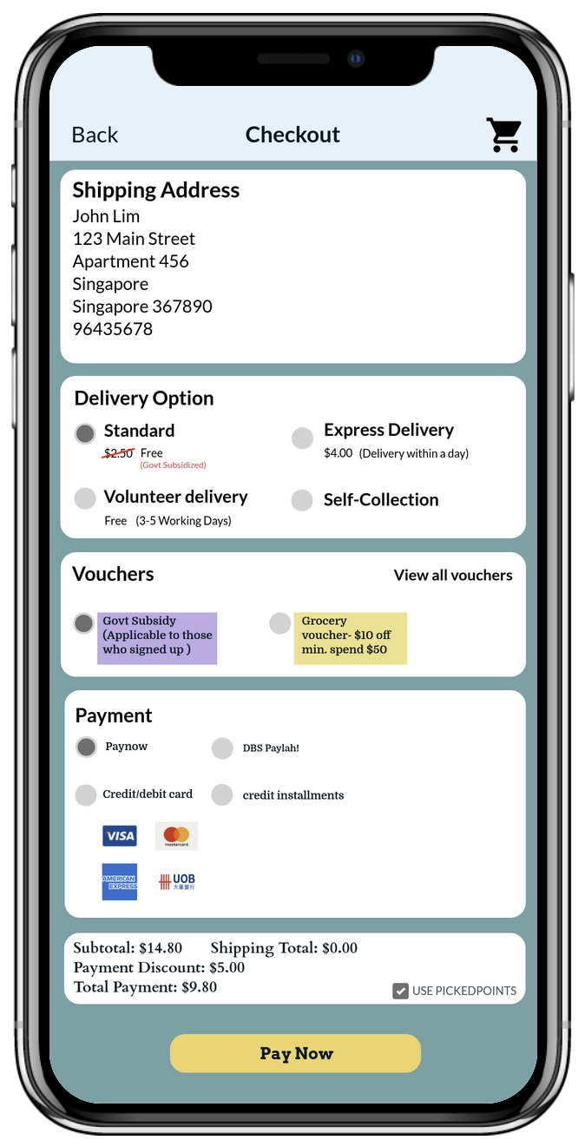
View shopping cart
Checkout page
Able to view finalised information
e.g. shipping address, delivery option, applied vouchers, payment method and using pickedpoints
Can view different items ordered via different marts
Vouchers are available fo the qualifying under financial schemes
Notes:
The app features a Shopping Cart and Checkout page for users to view their products added to cart as well as purchase of products.
In the Shopping Cart, users can apply subsidies voucher if they have, to further subsidies the product they are about to purchase.
It also sorts the product based on the Supermarkets or NGOs they purchase from for easier tracking.
In the Checkout, users can choose between multiple delivery options such as Standard, Express Delivery, Volunteer Delivery and Self-Collection.
If the user is under Financial Assistance, he or she will be able to obtain free delivery for their purchases to their home.
Vouchers such as Government Subsidy or Supermarket/NGOs voucher can also be used to further subsidies their purchases.
The user can use many supported payment type to pay for their products, such as PayNow, DBS PayLah!, Credit/Debit Card or even credit installments.

Slide 9
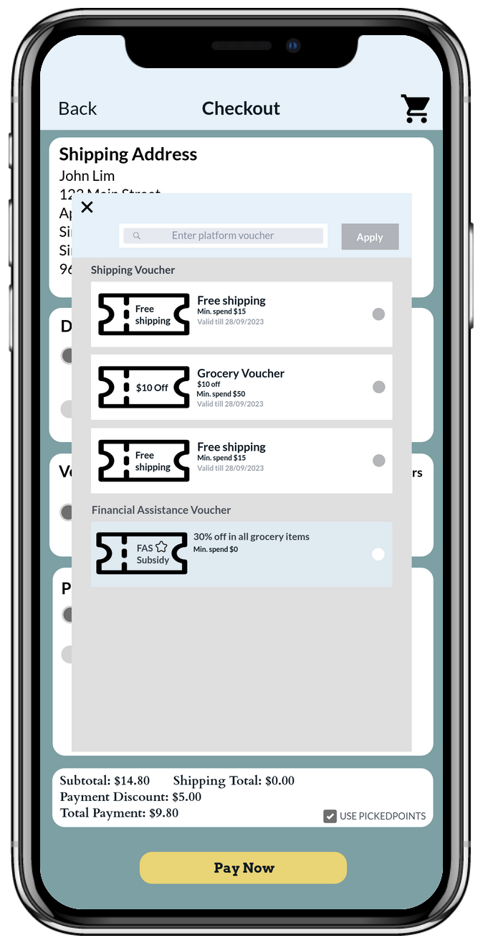
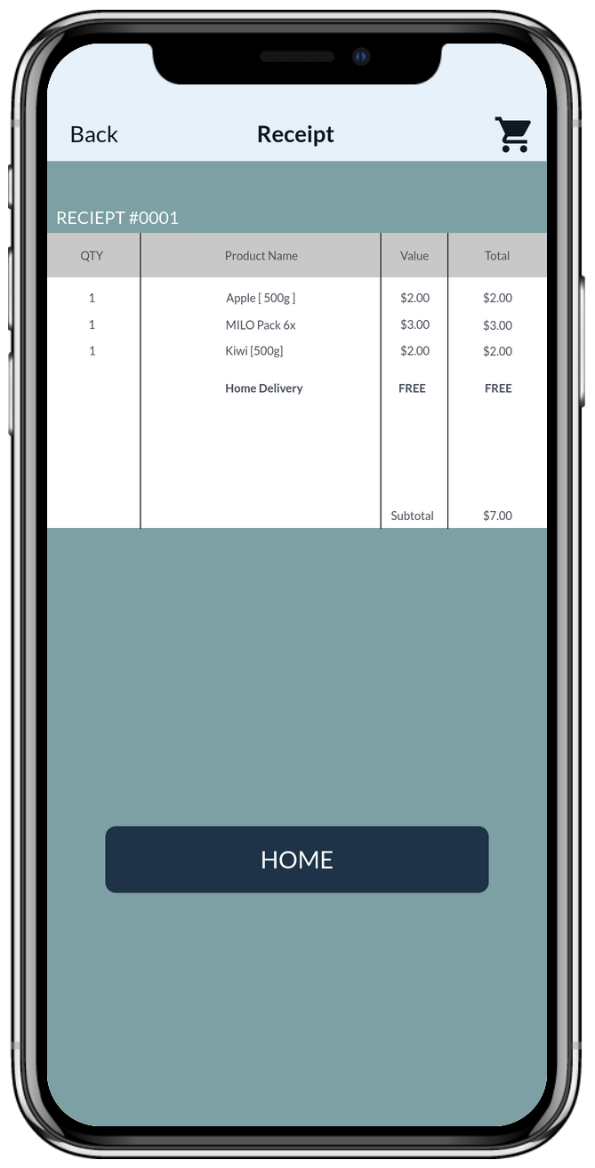
Sample vouchers for eligible consumers
E-Receipt page
Able to view ordered product and its prices
Notes:
The app features a Receipt for user to view their purchase.

Slide 10
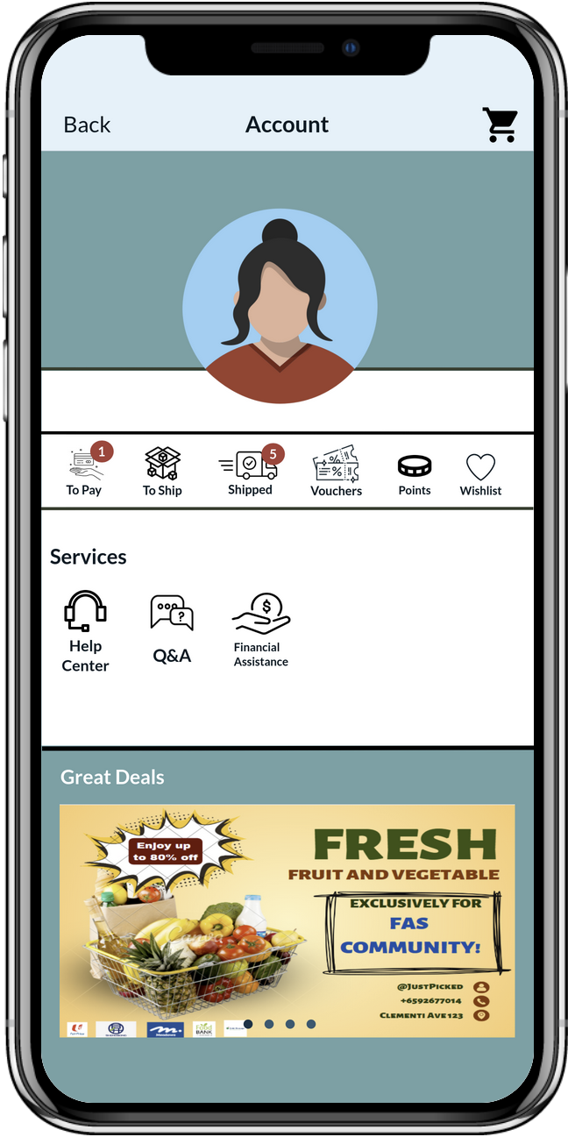
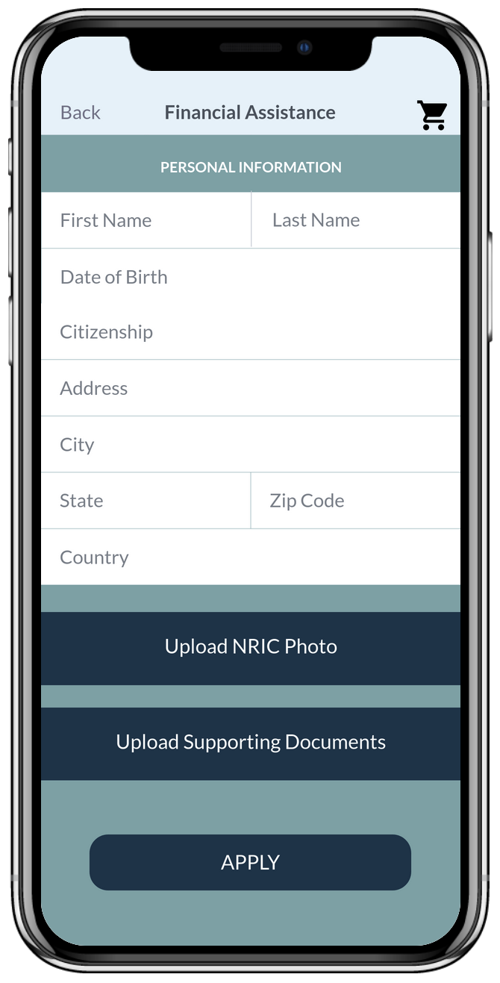
Profile/account page
Financial assistance page
Able to view progress of delivery
Able to view points
Able to see all vouchers available
Fill up all the details and submit supporting documents for Singaporeans
Able to view unpaid items
Able to apply for ‘financial assistance’ under ‘services’ section
Notes:
The app features a Account and Financial Assistant.
In Account, users can view products which they have yet to pay, yet to shop or shipped,
They can also view available vouchers they have as well as their product’s wishlist.
They are able to conduct support for help, read existing Questions and Answers, register for Financial Assistance and view the Low Income Support Page.
There is also limited deals show at the bottom of the page.
In Financial Assistance, users can register for Financial Assistance by providing their personal details, uploading of their NRIC and Support Documents for verification purposes.

Slide 11
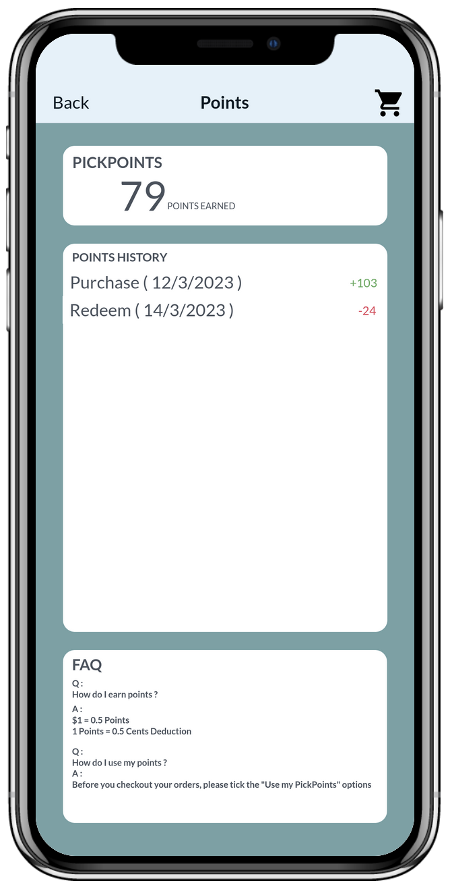
Able to see all their points available
Able to see their past points transactions
FAQ for those who need help with points system

Slide 12
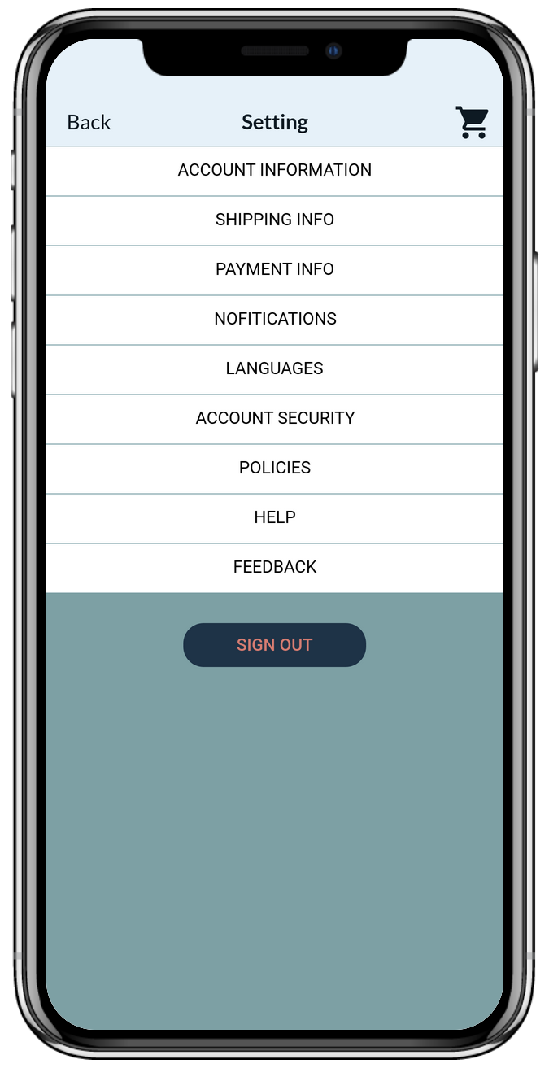
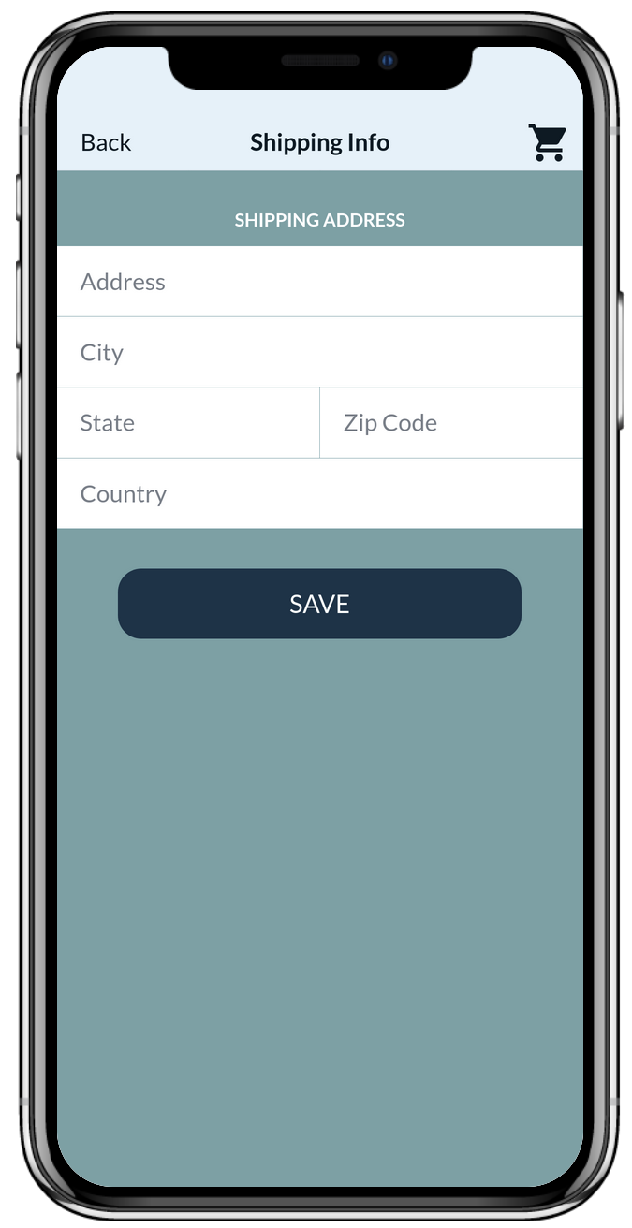
Setting page
Shipping info page
Able to navigate through different functions such as payment and shipping info
Update address for delivery
Able to provide feedback and seek help
Notes:
The app features a Settings and Shipping Info.
In the Setting, users can navigate to different settings available such as Account, Shipping Info, Payment Info, Notification, Languages or Account Security.
In the Shipping Info, users can change or add new shipping address where the products will be delivered to.

Slide 13
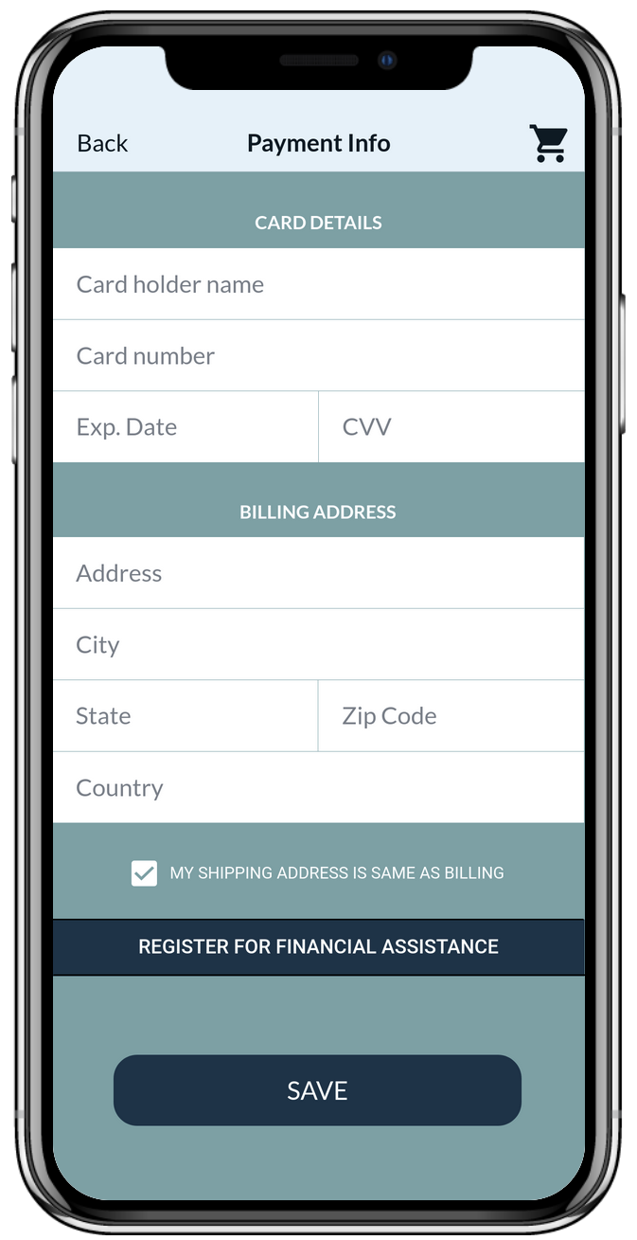
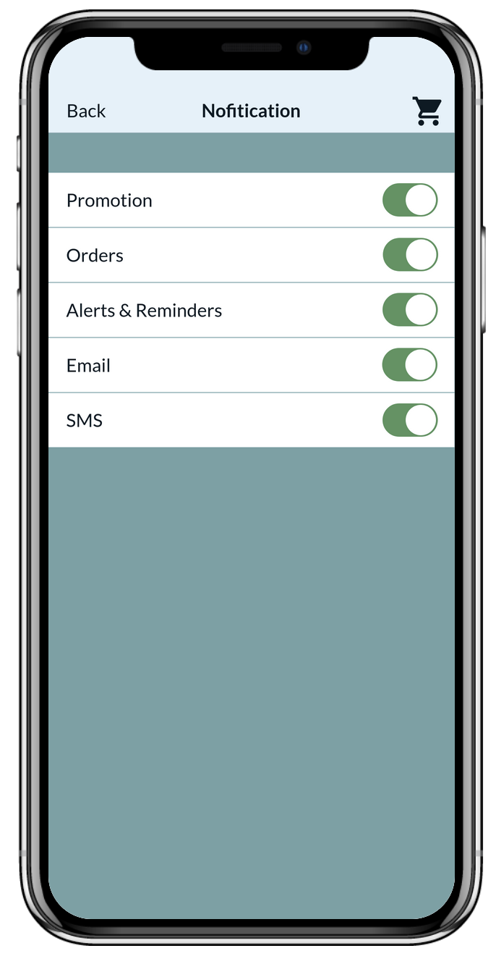
Payment Info page
Notification page
Able to update payment method
Promotion offers, order update will be sent
Update address for delivery
Notes:
The app features a Payment Info and Notification.
In the Payment Info, users can change or add new payment details to pay for their products.
In the Notification, users can opt for notifications from the app such as Promotion, Orders, Alert & Reminders, Email or SMS.

Slide 14
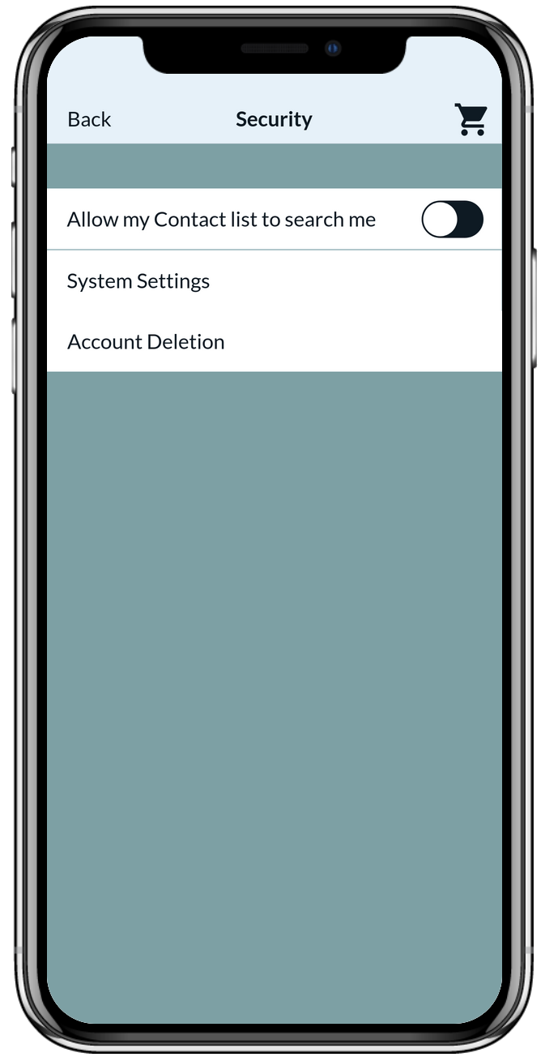
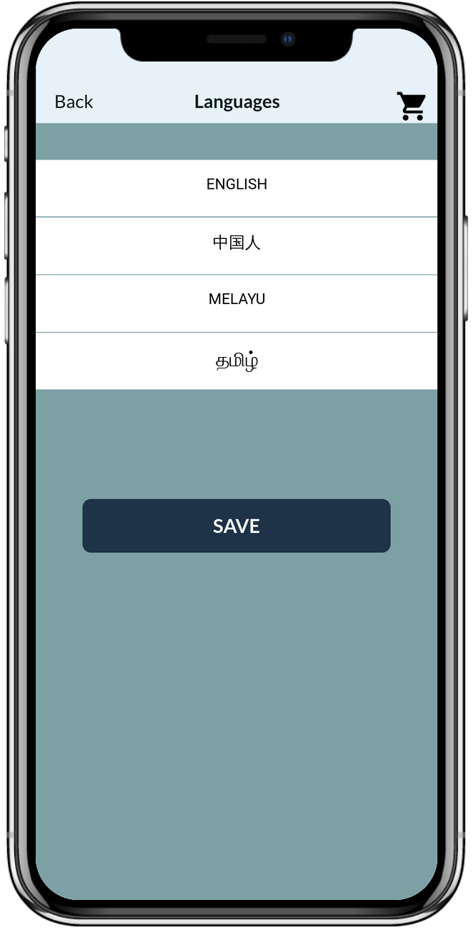
Security page
Users are able to choose which language their are most comfortable in
Notes:
The app features a Security and Languages.
In the Security, users can opt to allow their contact list to search them in the app, change system settings or delete their account.
In the Languages, users can change into different languages available.

Slide 15
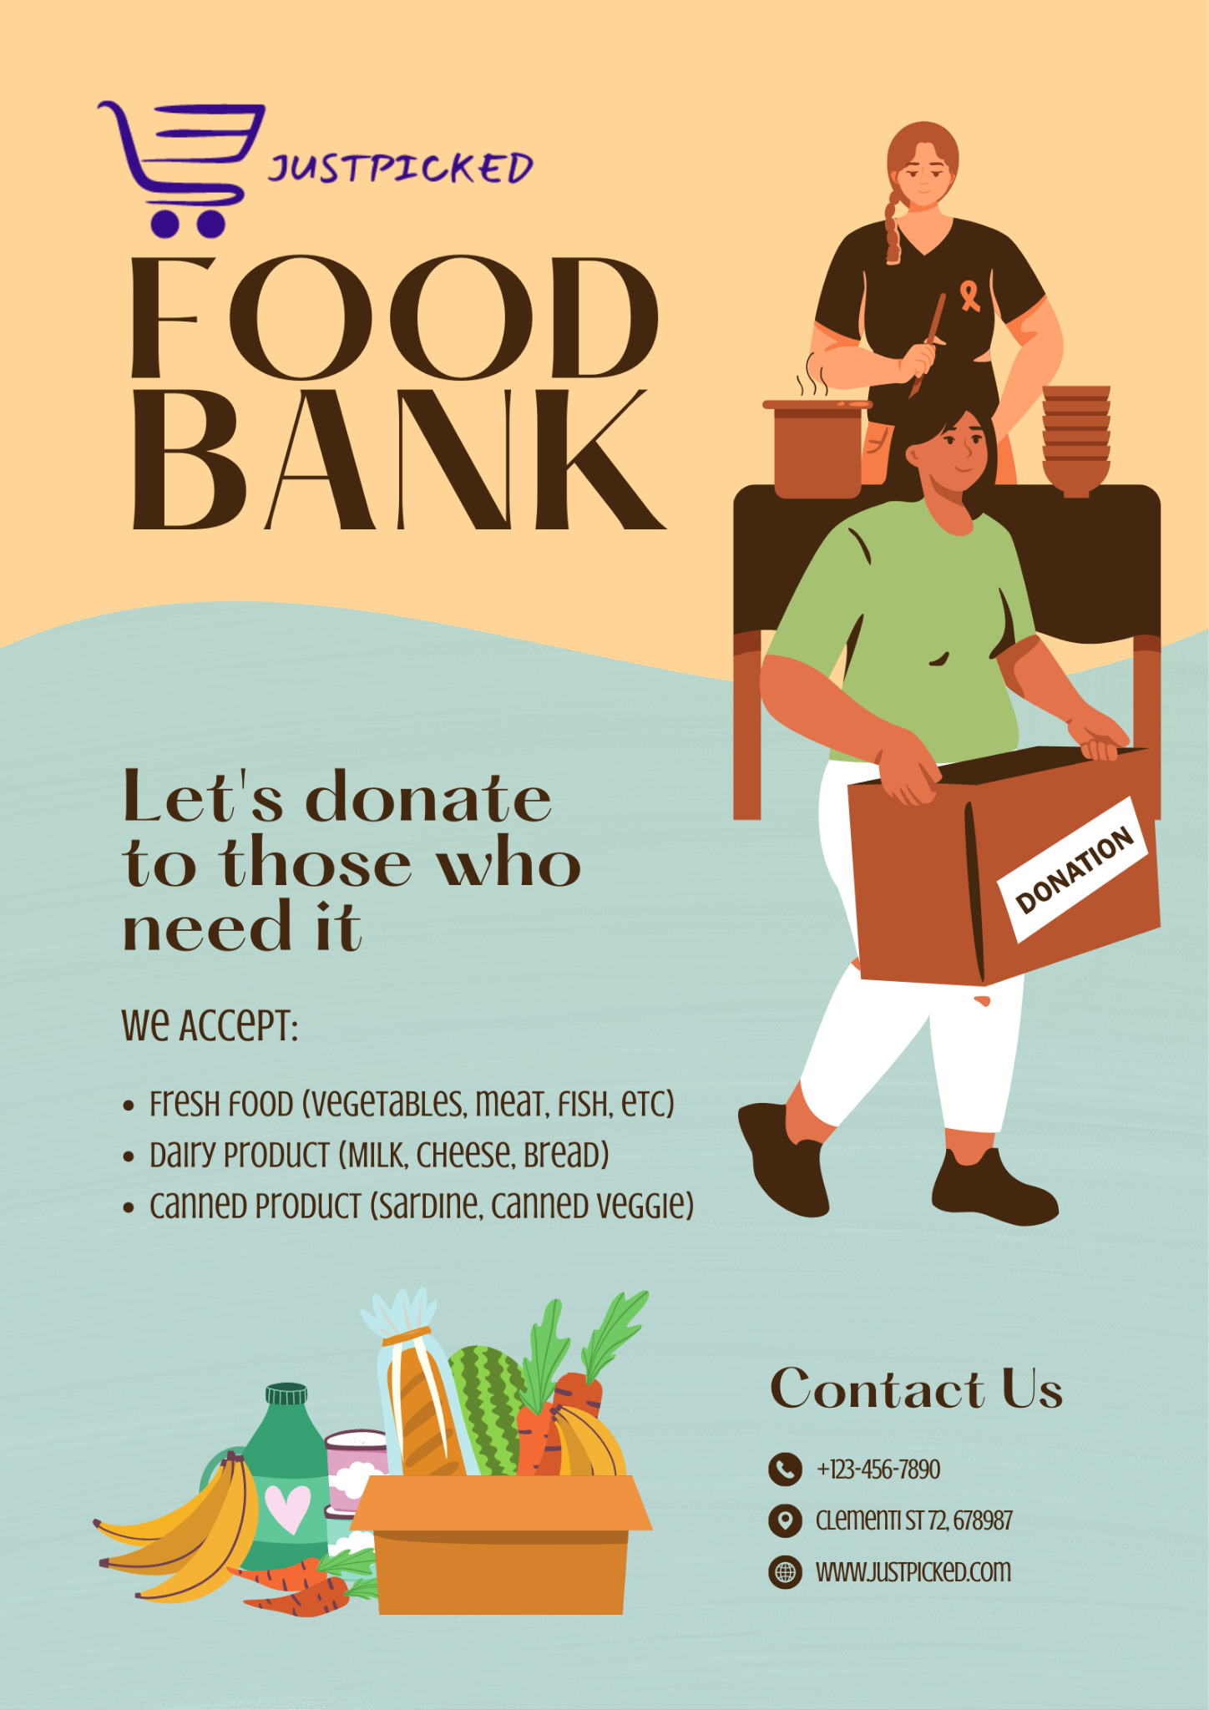

Marketing Collaterals (Indirect)
Notes:
Posters showing JustPicked collaborating with FoodBank, where people are advised to donate spare foods to those who in need.
NOTE :
This is just a concept/idea, we are not in collaboration with any organisations throughout this assignment.

Slide 16
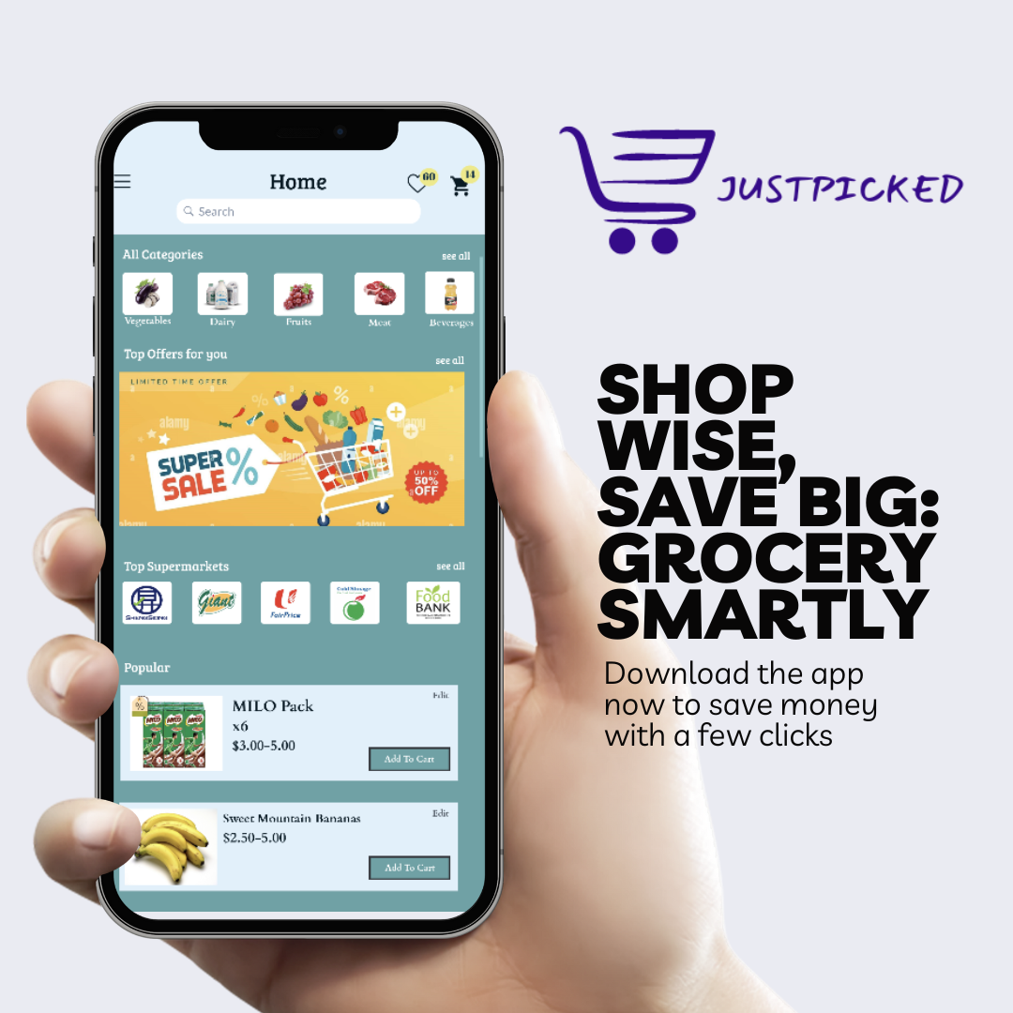
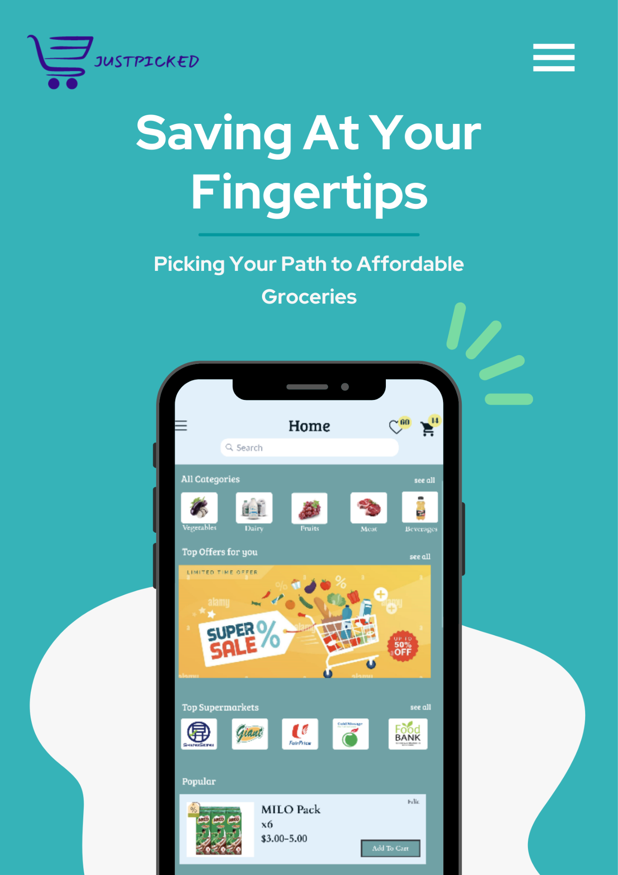
Marketing Collaterals (App)
Notes:
Posters featuring our App.

Slide 17
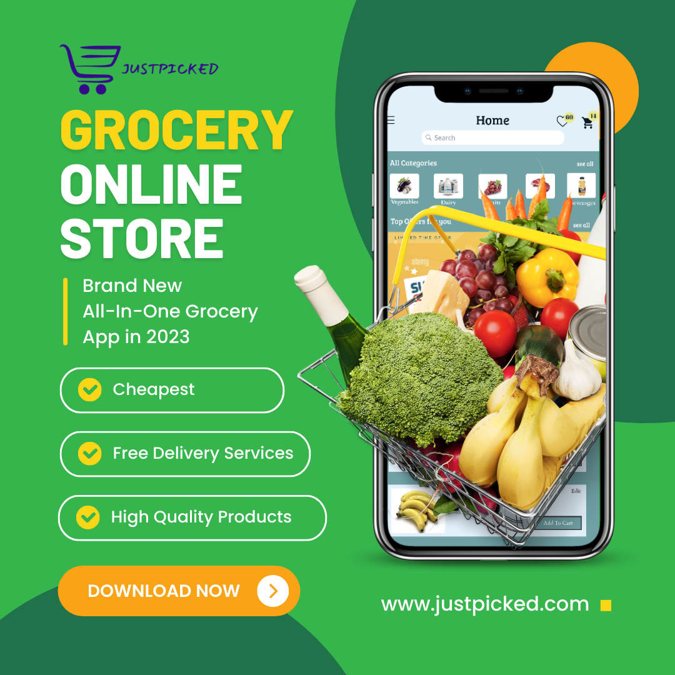
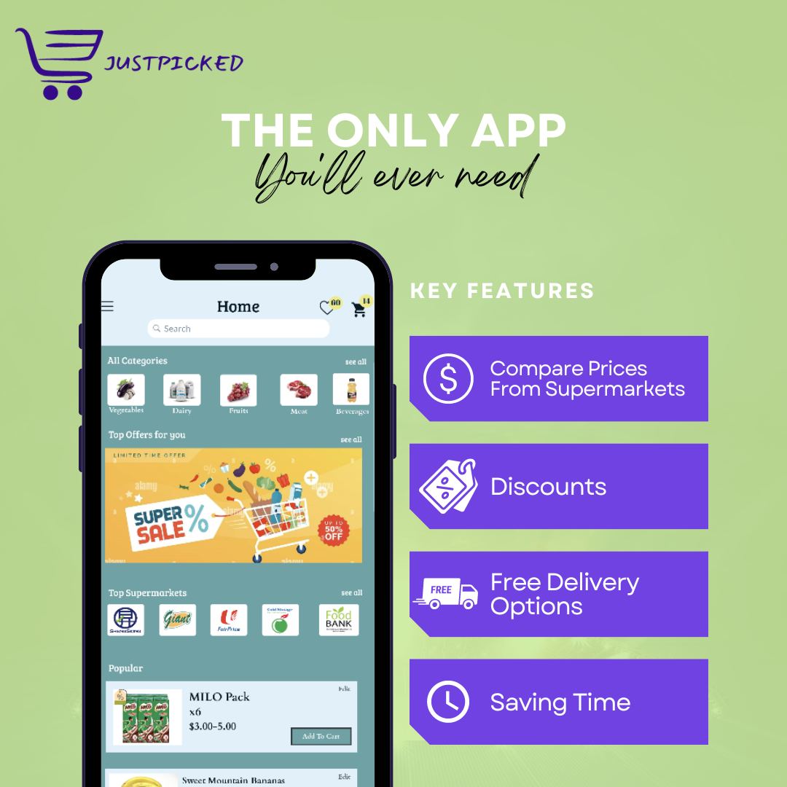
Marketing Collaterals
Notes:
Posters featuring our App.

Slide 18
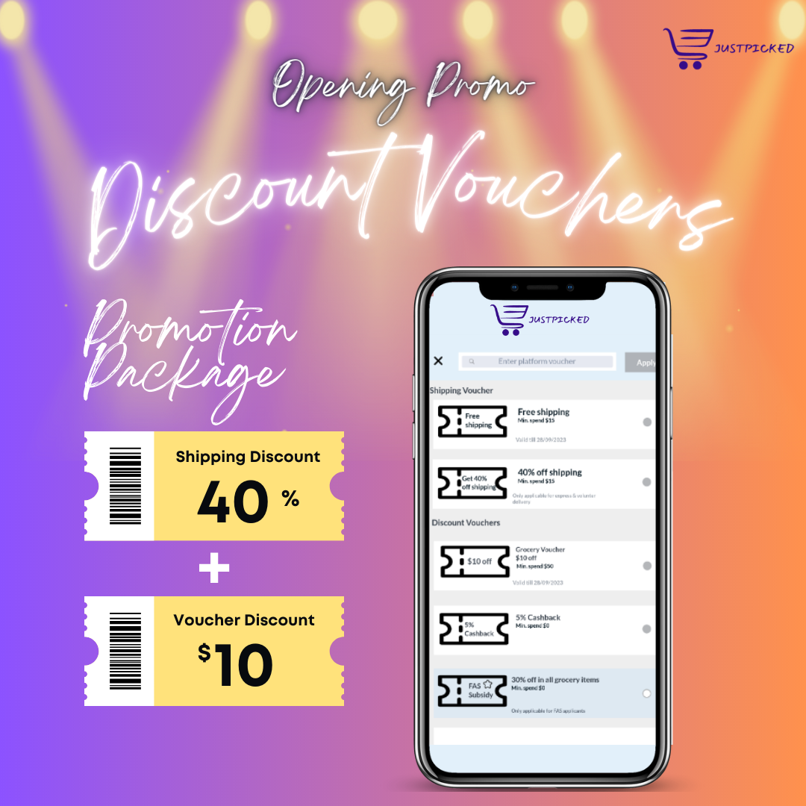
Marketing Collaterals
Notes:
Posters featuring our App.

Slide 19
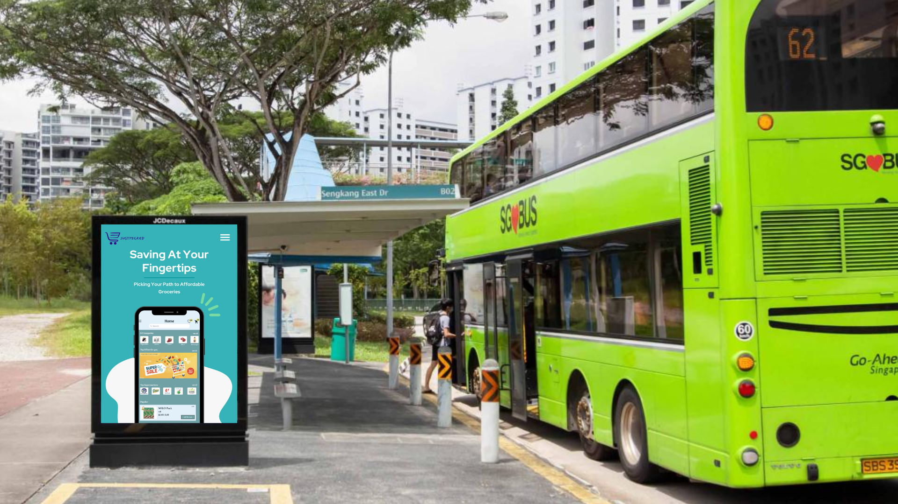
Marketing Collaterals (Offline)
Notes:
Digital Advertisement on Bus Stop showing our App
NOTE :
This is just a concept/idea, this is not shown on the Bus Stop Digital Board.

Slide 20
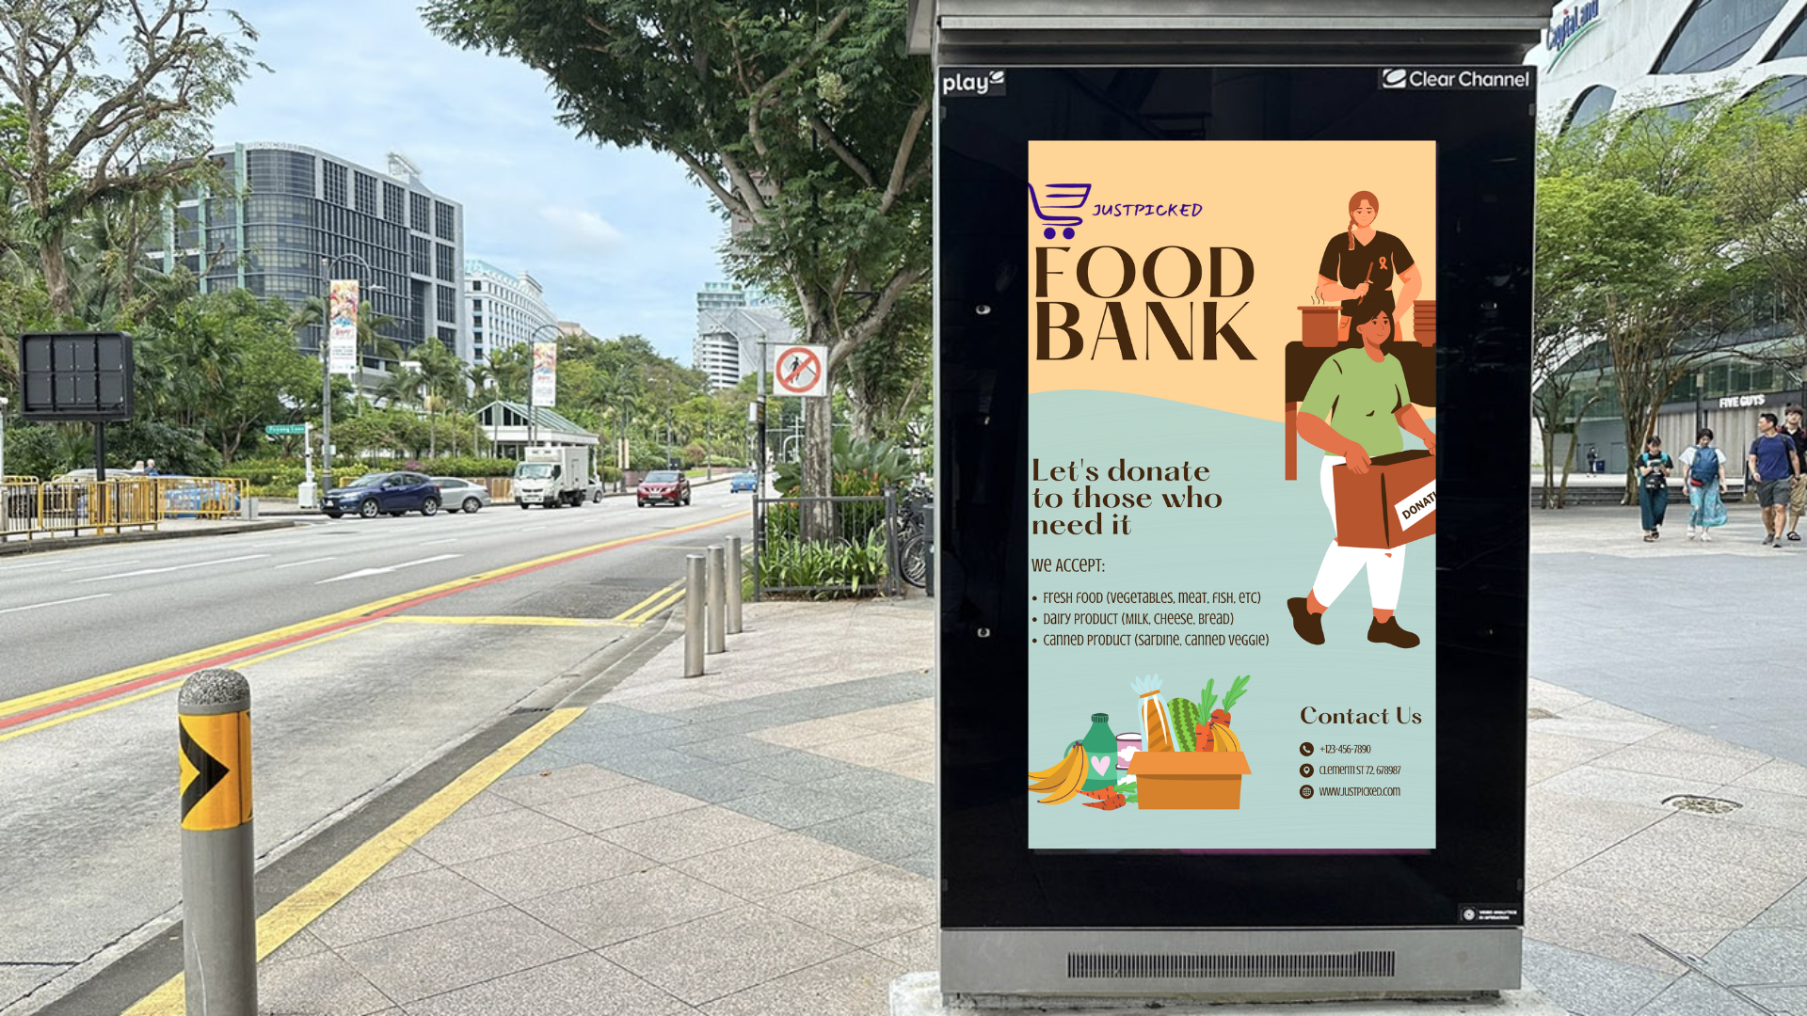
Marketing Collaterals (Offline)
Notes:
Digital Advertisement on Bus Stop showing our App
NOTE :
This is just a concept/idea, this is not shown on the Bus Stop Digital Board.

Slide 21
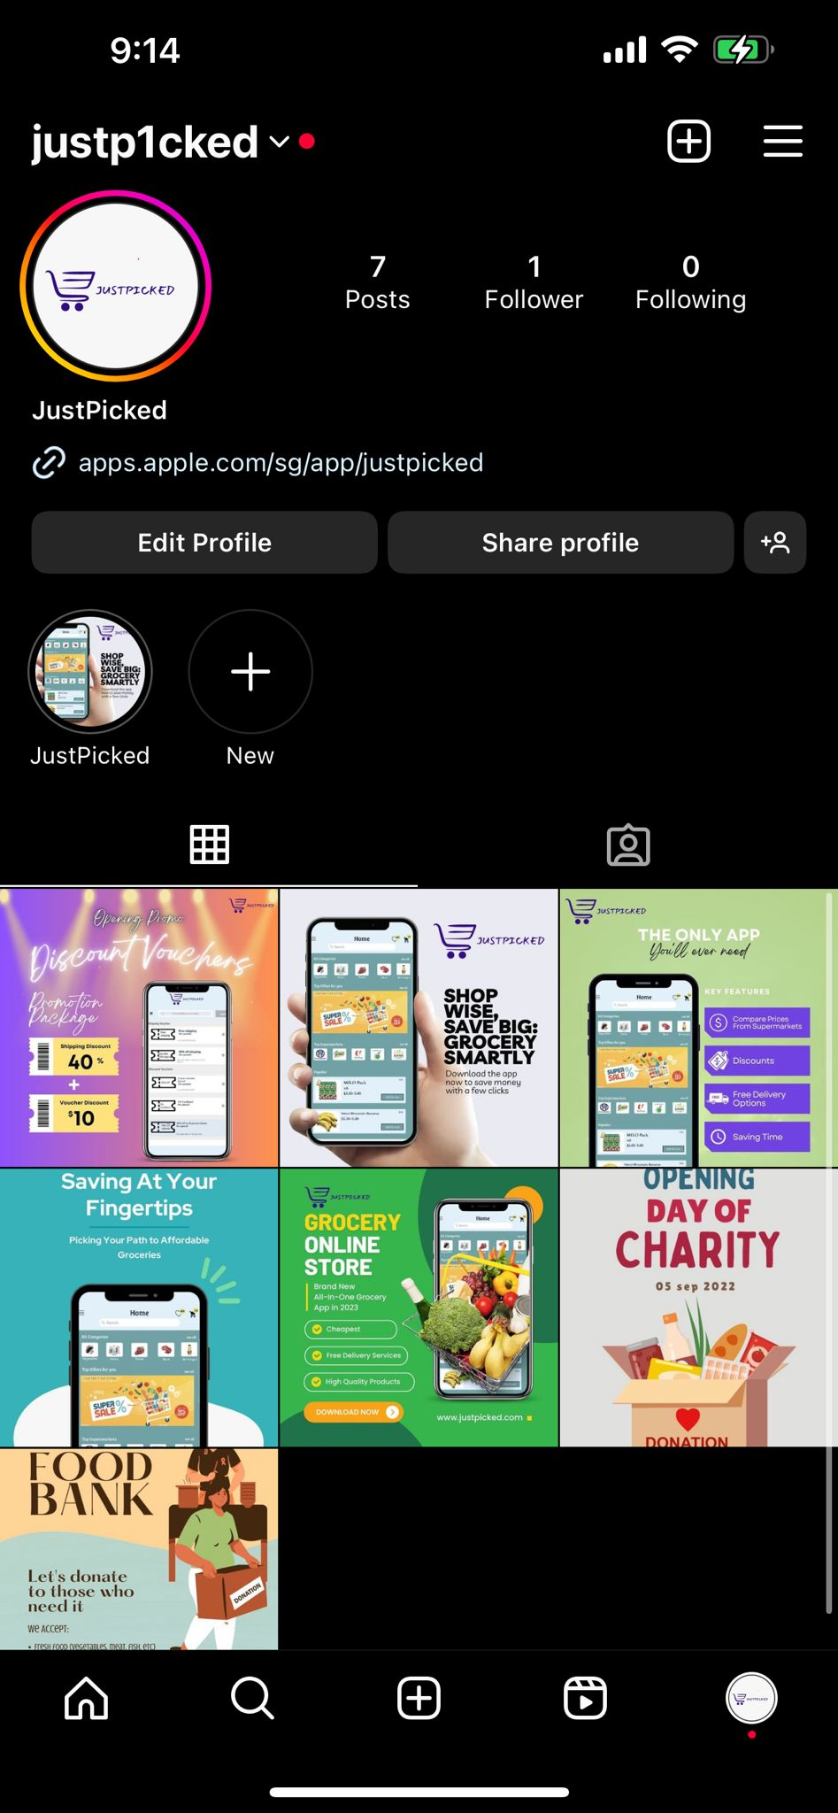
Marketing Collaterals (Instagram)
Notes:
JustPicked’s Social Media Page, showing incoming and ongoing events and promotions.

Slide 22
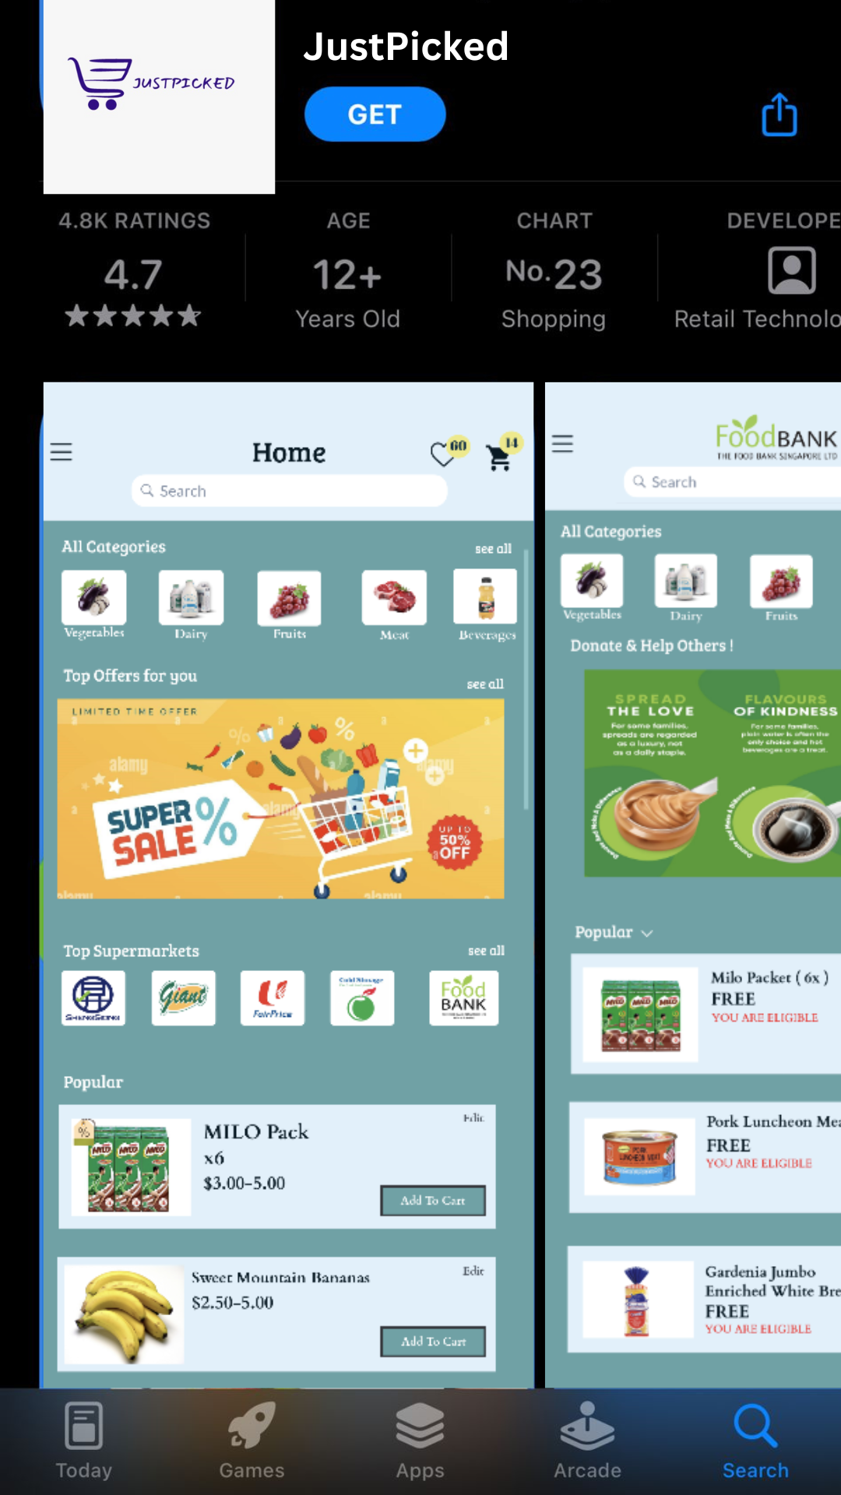
Marketing Collaterals (Appstore)
Notes:
JustPicked App on AppStore.
NOTE :
This is just a concept/idea, this is not listed on the AppStore/PlayStore.

Slide 23
Thanks!
Notes:
Thank you for listening, we will now be proceeding to the Q&A

